Slide 1






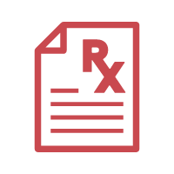








Prism Mapping Layer
Refraction Iteration
Layer
Prism Focusing
Layer
Drug Info Retriever
DDI Detector
Retrospector
Medication on Admission
Safety Checker
Allergies
Patient Input
Prescription
Final Prescription
Past Medical History
Safety
Interpretability
Traceability
Demographics
Info Classifier
ADR Evaluator
Prescription
Generator
DPI Detector
Doctor Diagnosis
Retrospection for next round
PRISMATIC Framework
Prescription Risk Inspection System for Multi-Agent Tactical Interaction in Clinical Decision

Slide 2



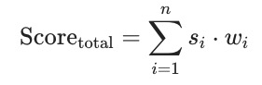

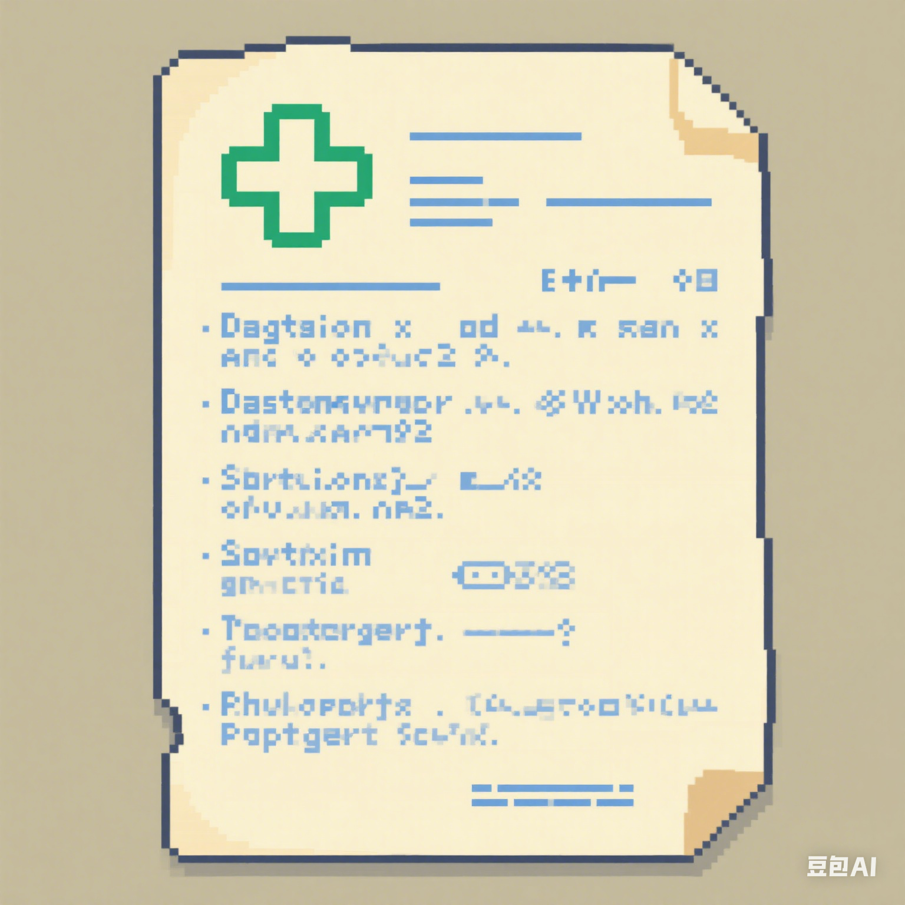






Prism Mapping Layer
Refraction Iteration Layer
Prism Focusing Layer
Input
Safety Check
Output
"
Dynamic Self-update Weights
"
"
Chief Complaint: Pain Headache
Allergies: lisinopril
Family History:
Family history of early MI, arrhythmia, cardiomyopathies.
Medication on Admissions:
1. Aspir-81 (aspirin) 81 mg oral DAILY
2. Rosuvastatin Calcium 10 mg PO QPM
…
Weights: [0.28,0.21,0.2,0.1,0.09,0.1]
Conflict_score: 95,
Dosage_score: 92,
Duplication_score: 100,
Context_score: 100,
Physical_score: 89,
Coverage_score: 100,
EvaluationSummary: Overall, the prescription of Acetaminophen for pain relief in the setting of intra-parenchymal hemorrhage is deemed safe and appropriate. No conflicts, dosage issues, duplications, context conflicts, physical conflicts, or coverage gaps were identified.
Evaluation Score(>85):
Prescription List:
[
DrugName: Amlodipine,
UsagePlan：Take 5mg once daily for blood pressure control. May adjust based on response and tolerance.
AdminstrationRoute： Oral,
],
…
Weights: [0.29,0.22,0.17,0.1,0.12,0.1]
"
Focusing
"
Mapping
"
= 93.93
Classify and Analyze
"
Prescription Iteration
Allergy Analysis:
Avoid using ACE inhibitor drugs such Enalapril, Ramipril, Perindopril, etc.
Alternative options: ARB drugs (such as Losartan, Valsartan)
Current Medication:
Aspirin and Rosuvastatin Caution.
The combination with aspirin increases the risk of gastrointestinal bleeding.
Combination with statins may increase the risk of nephrotoxicity.
It is recommended to use Acetaminophen as the first-line painkiller first.
Patient Demographics:
If antihypertensive drugs need to be added, ACEI should be avoided. It is recommended to closely monitor blood pressure and renal function.
...
Final Prescription
Amlodipine 5mg QD
Acetaminophen 500mg PRN
(No Conflict)
Output Prescription
Hospital Prescription
Contrastive
Reflection
…
"
Drug
Instructions
Revised Prescription 1
Atenolol 25mg QD β-blocker
Ibuprofen PRN
(Family Illness Risk)
Differences:
Added : Acetaminophen,
Removed : Aspir-81 (aspirin) 81 mg
Guidance:
Combine safe and effective analgesics to enhance pain management and improve patient comfort without affecting existing treatments.
…
DDI detector
Prescription
Guidance
from
Retrospection
ADR Files
DPI detector
Initial Prescription
Lisinopril 10mg QD
Ibuprofen PRN
(Allergy Conflict)
"
"

